Slide 1

SWARNA MALIGAI JEWELLERS
Nanganallur , Chennai

Slide 2
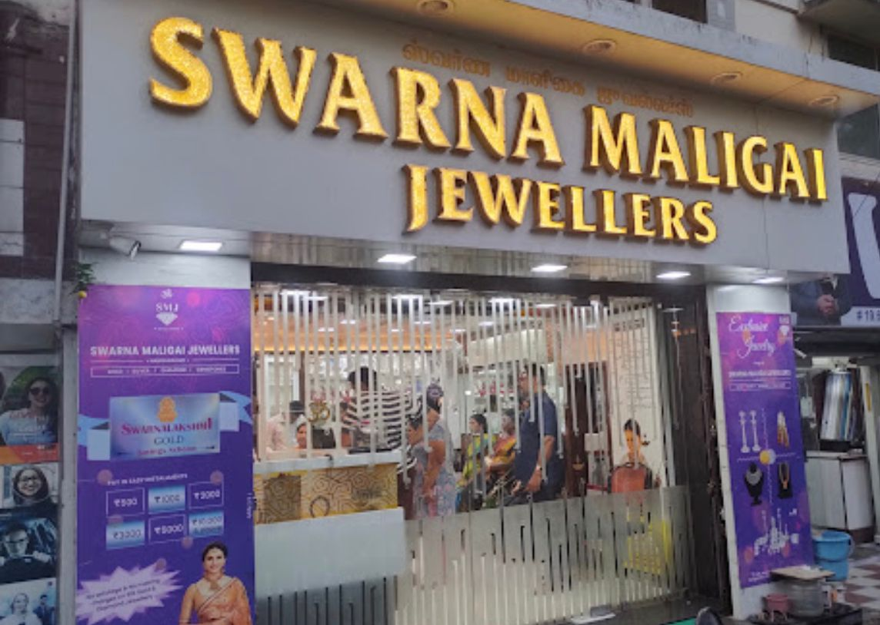
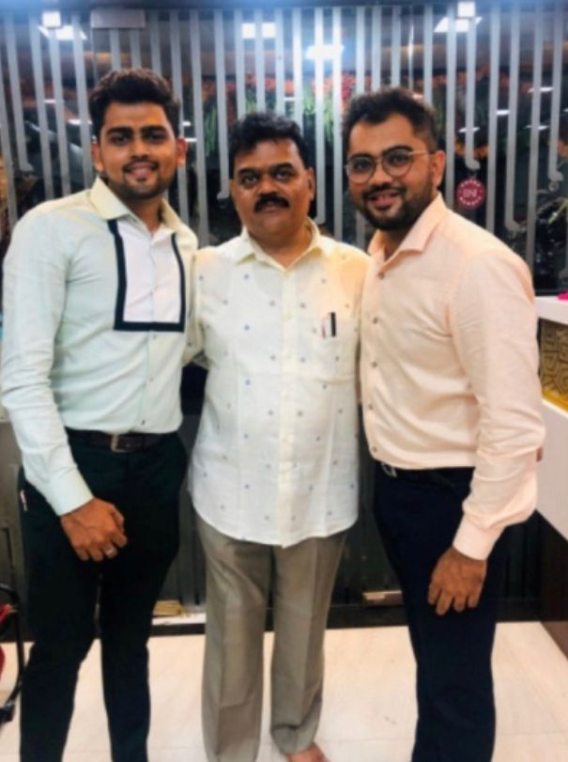
About SMJ
Our showroom was established in 1986 by my father. Today, myself and my elder brother are helping him run the business forward.
Our showroom has connected, invited and attracted millions of customers till date and half of which are repeat customers who do not wish to buy jewellery other than SMJ.

Slide 3
A good piece of jewelry is like a good friend— it’s never too late to find one.

Slide 4
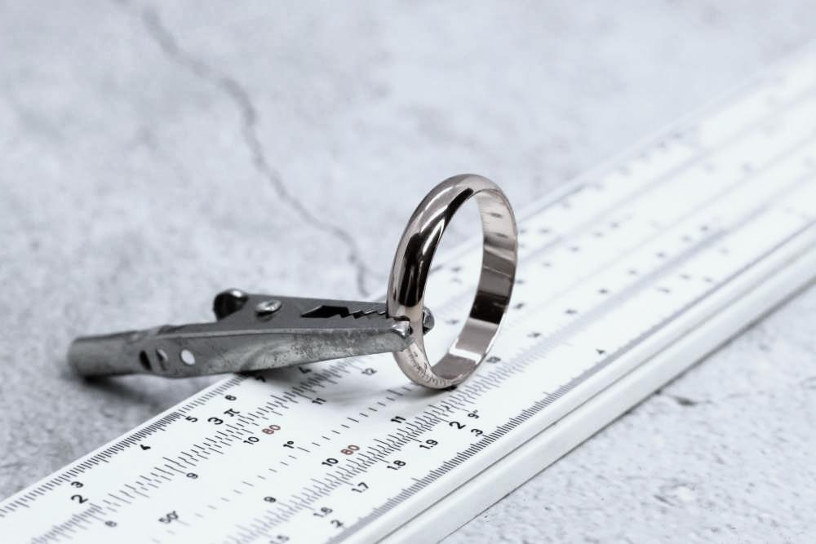
Core Values
Nambikkai
Nanayam
Kairasi

Slide 5
Showroom Exclusivities

Slide 6
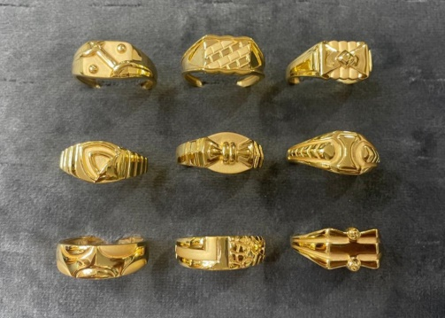
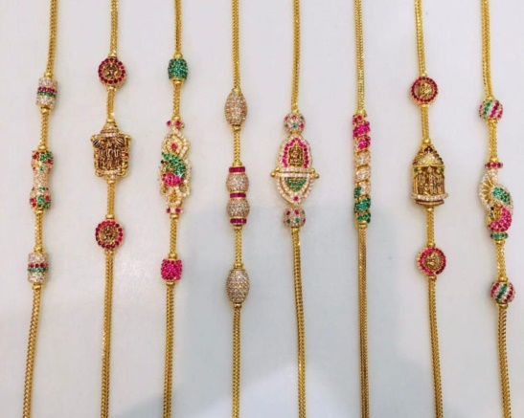
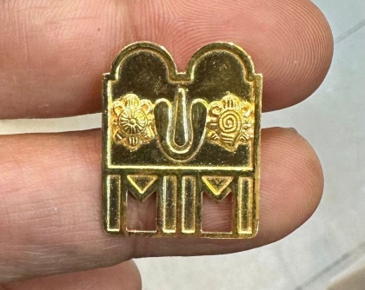
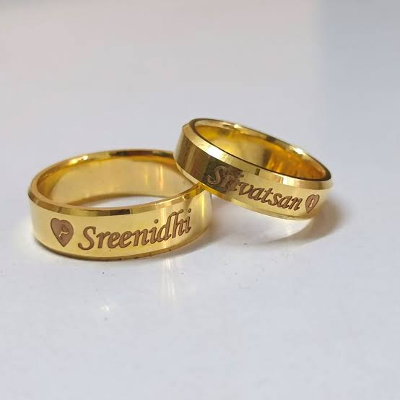
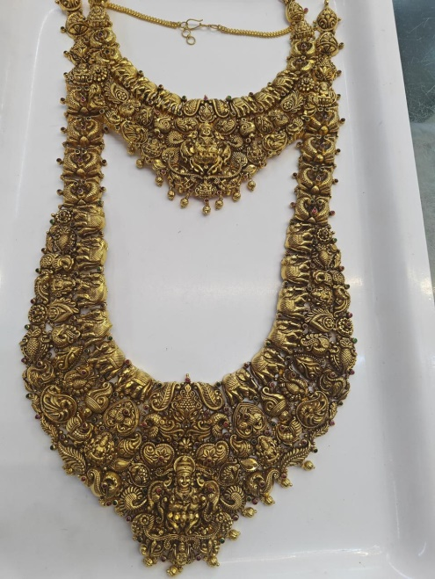
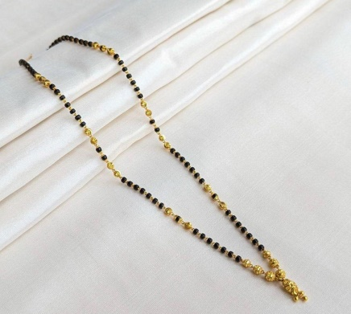
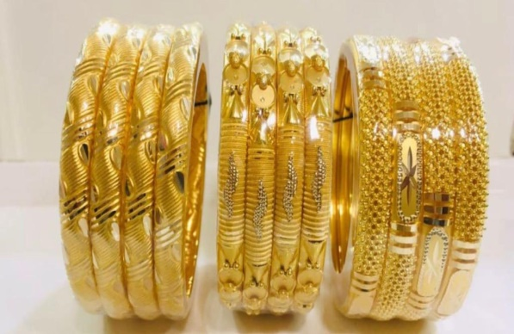
Gold
Daily wear Jewelry
Bridal wear Jewelry
Customised Jewelry

Slide 7
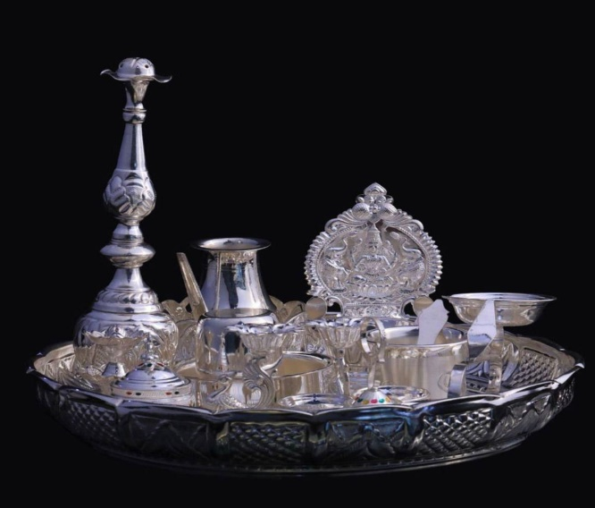
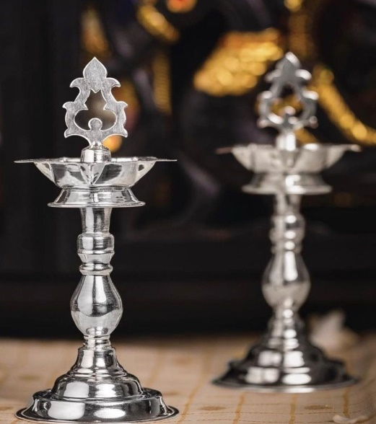
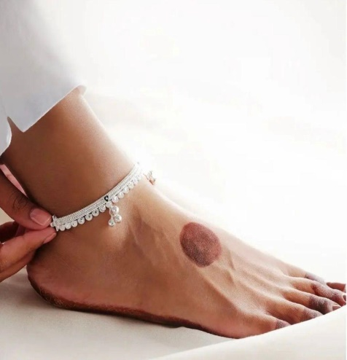
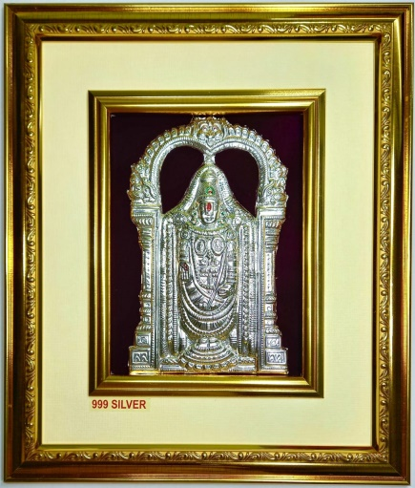
Silver
Silver Pooja articles
Anklets
92.5 silver rings, bracelets, bangles & watches
Idols
Photo Frames and many more…

Slide 8
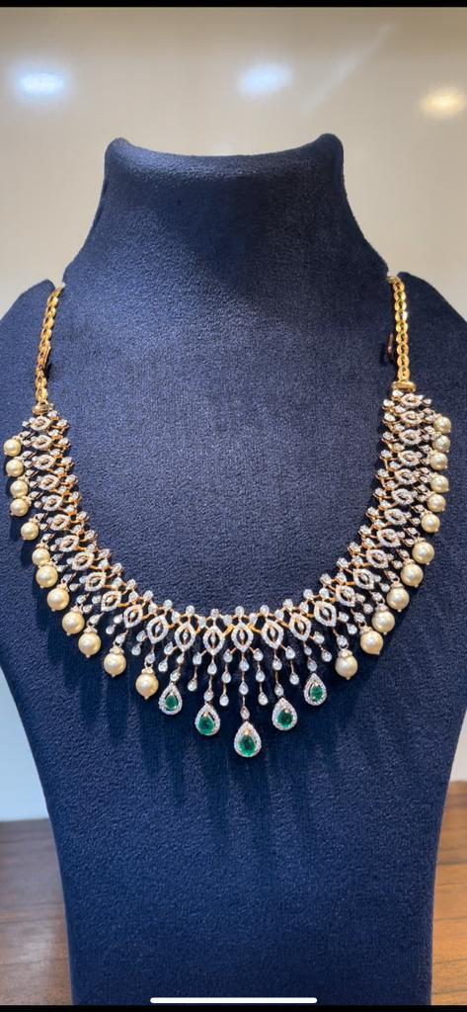
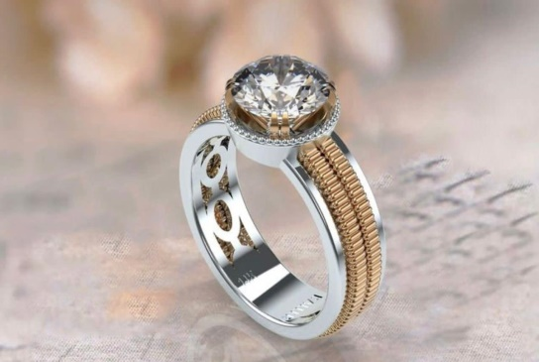
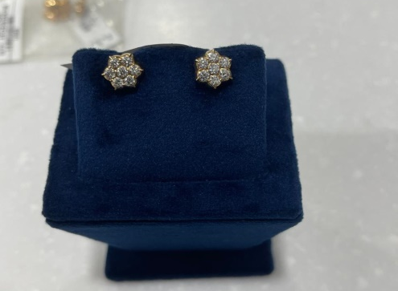
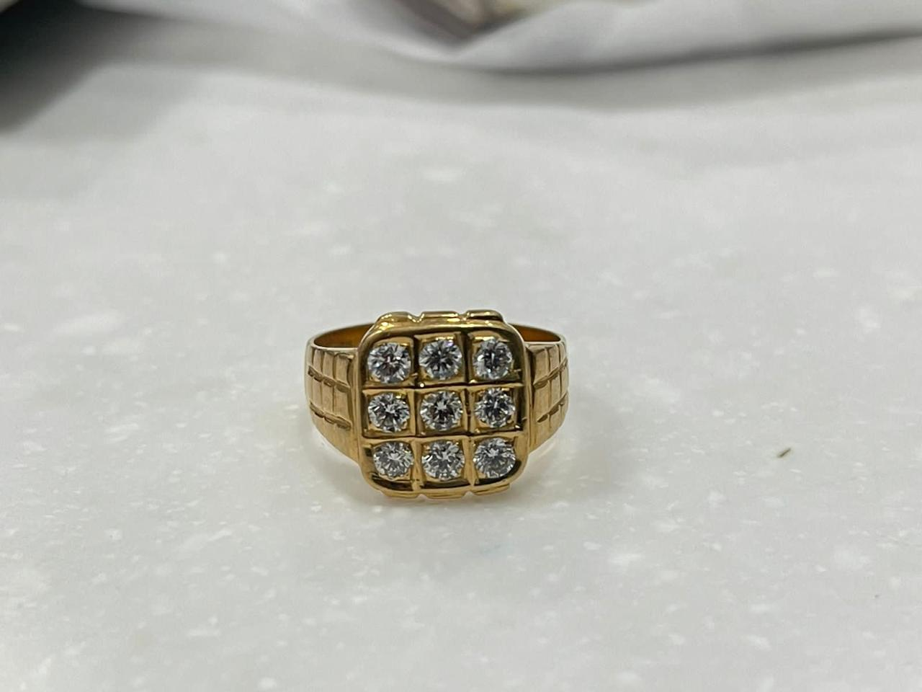
Diamond
Solitaires
Earrings
Nose Pins
Necklace and Harrams
Bangles, Rings, Bracelets
And many more…

Slide 9
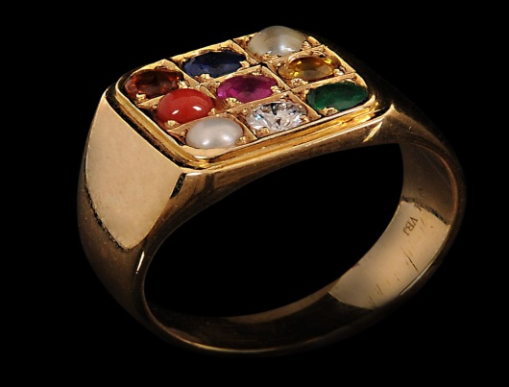
Precious Gem Stones

Slide 10

Why SMJ?
Minimum wastage
Less Stone weight
Discounts and offers
Per Carat offer
Discount on bulk orders
Gold Chit Scheme
Trusted jewelry store
Speedy deliveries

Slide 11


Follow Us

Slide 12
Specific Gives
Specific Asks
Dr. Harish CL Metha – MNM College
Mr. Dinesh – Brown Tree
Mr. Paras Bafna – Bafna Pharma
Mr. Ramachandran – Real Estate
Mr. Sunil Kumar – Swiss Cream Bangalore
Mr. Pavan Kumar – Lifestyle Galleria, Madhavaram
Dr. Priya – Apollo Hospital
G. Balachandran – IAS Officer
Bride and Groom who is getting engaged/ married
Sisters, Wives, Mothers of each member.
Those family members living abroad

Slide 13
Thank You

